Slide 1
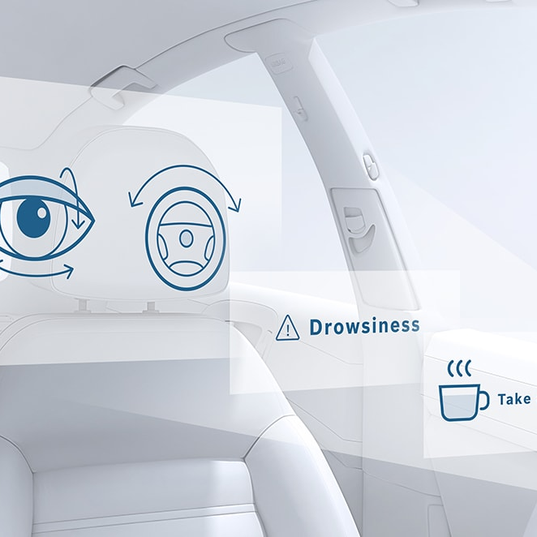
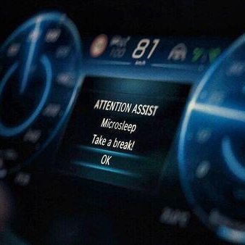
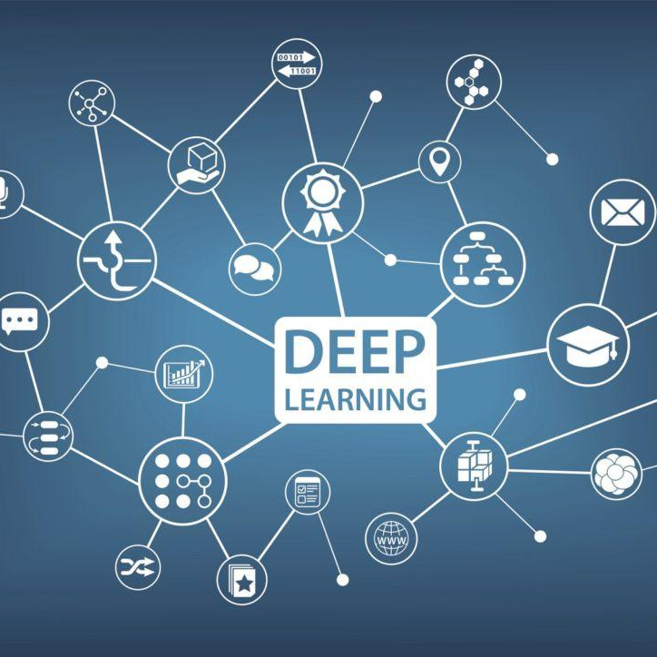
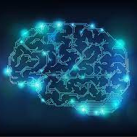

In-Browser Raster Data Processing
Vishnu Raj Cherukudi Mattuvayil

Slide 2
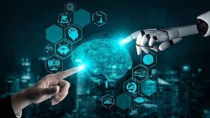



Outline
Introduction
Existing Methodologies
Implementation
Results and Discussion
Conclusion
Scope for Future Work
.

Slide 3
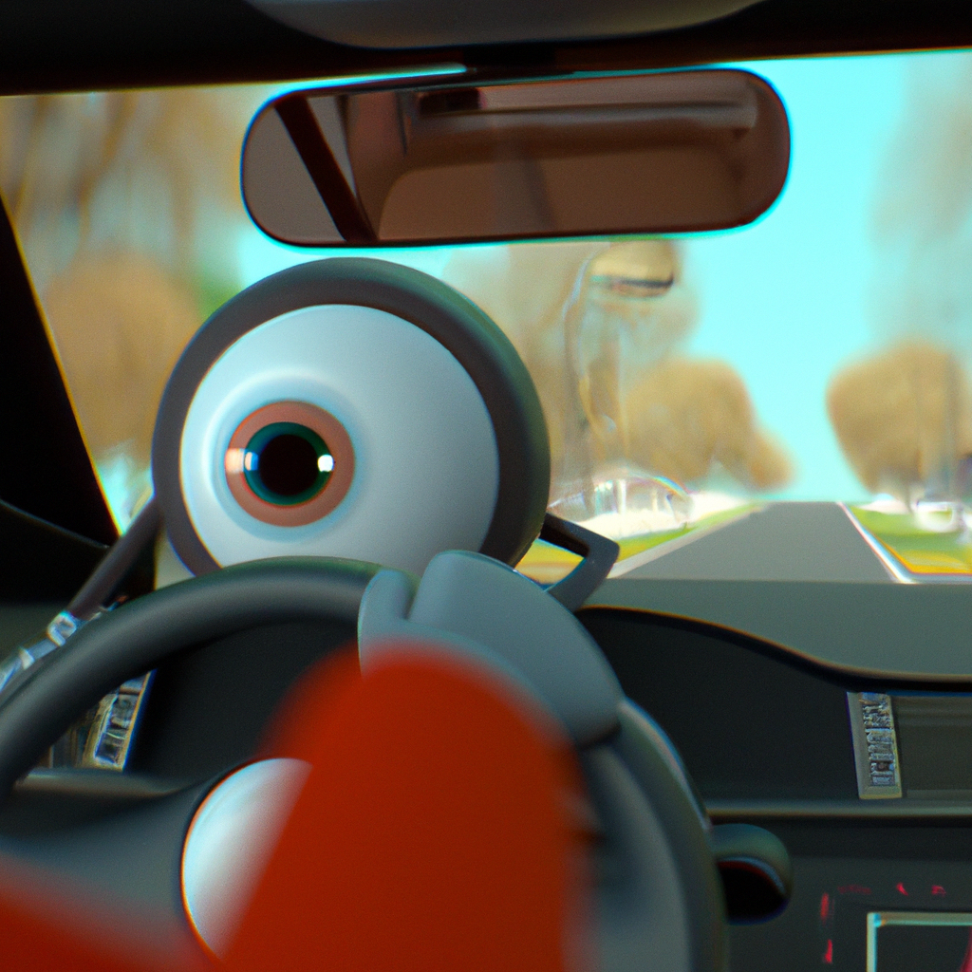
INTRODUCTION
What is raster data?
What is Web Assembly?
Understanding the impact of raster data processing on web application.
Improving the user experience and performance.

Slide 4

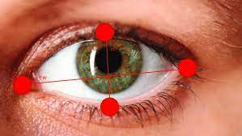
EXISTING METHODOLOGIES
EEG-Based Microsleep Detector using Micro controller
Brain waves
Real Time Drivers Drowsiness Detection and alert System by Measuring EAR
Eye aspect ratio

Slide 5
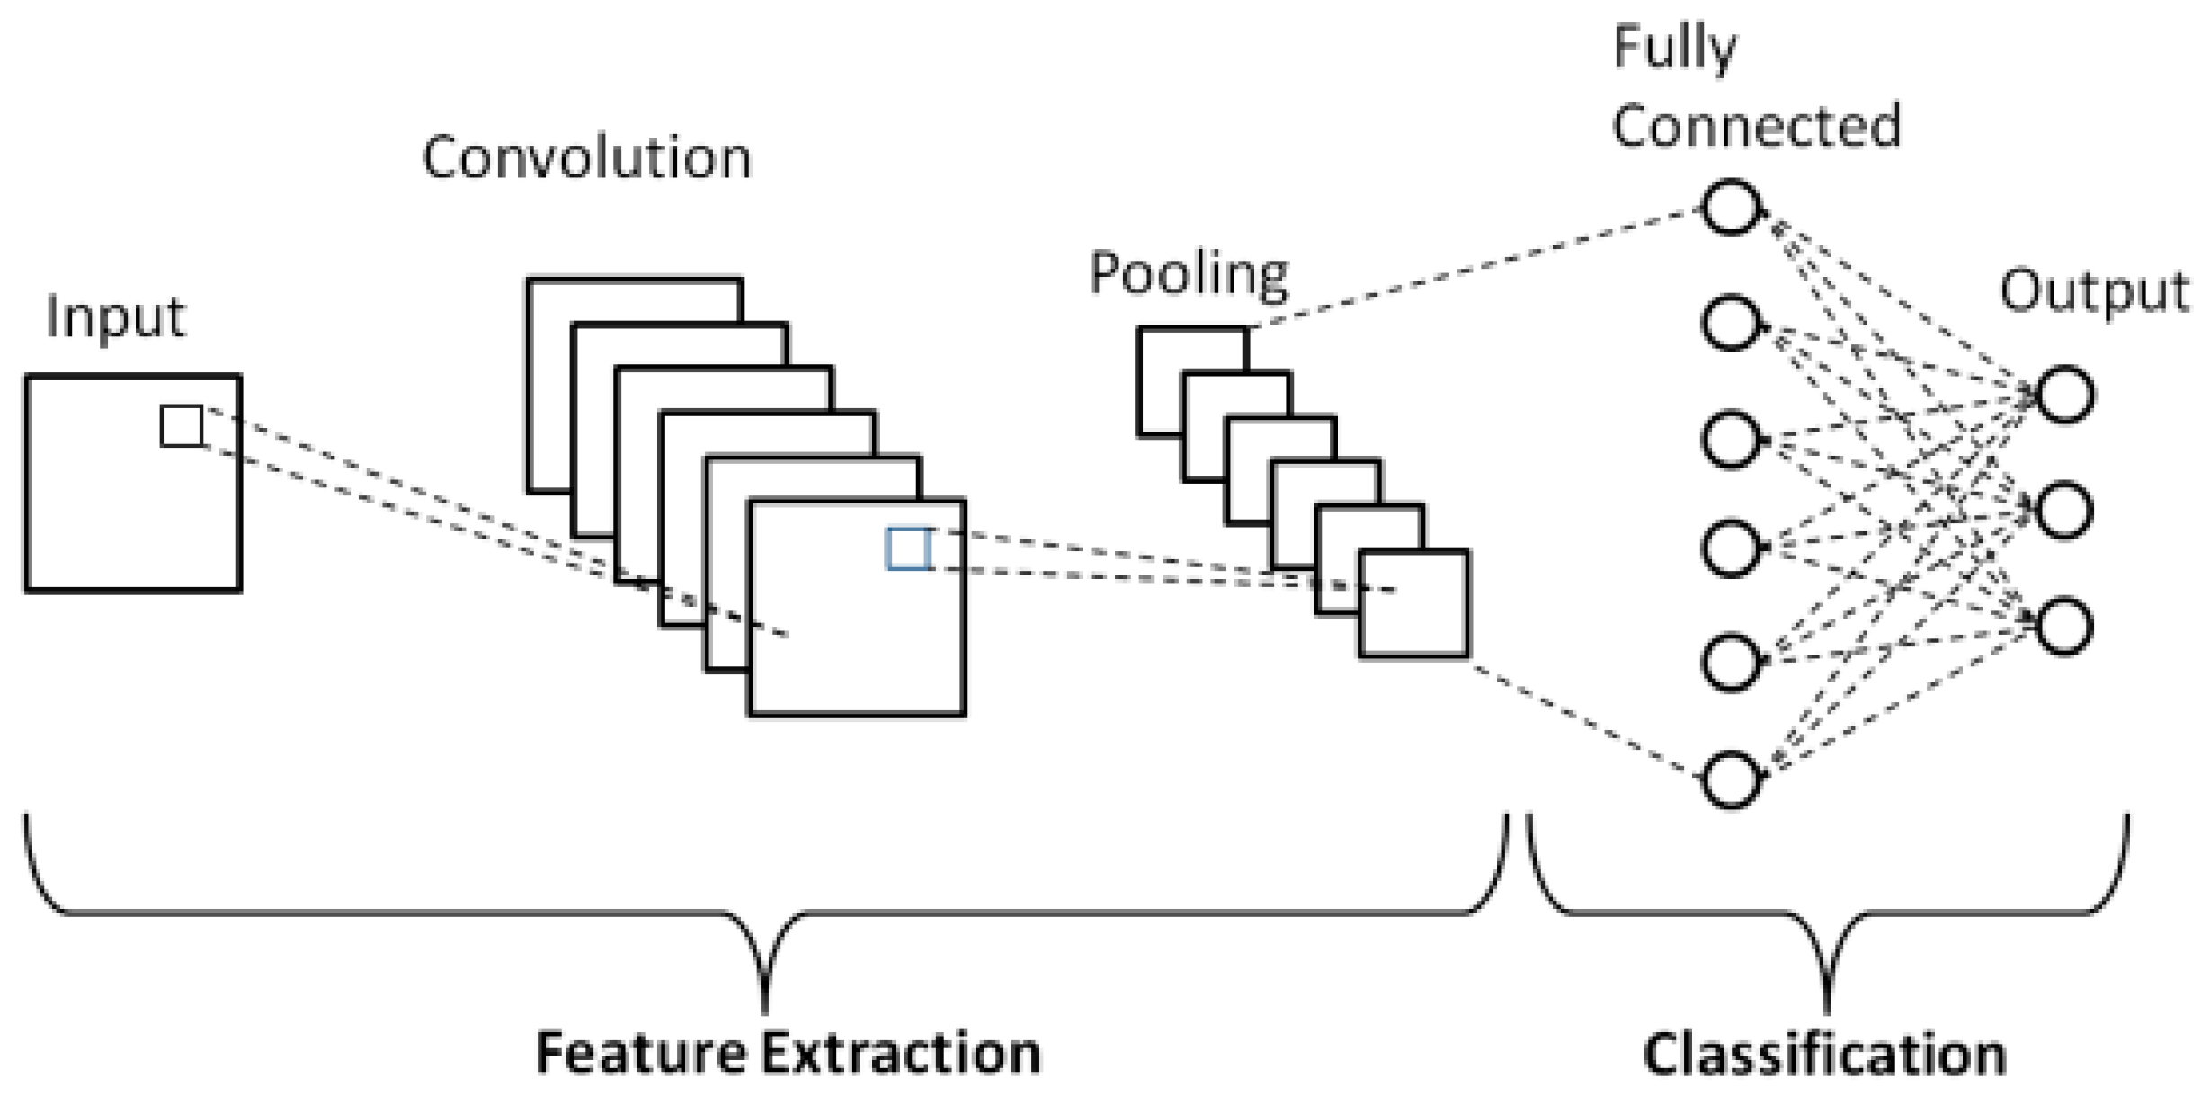
IMPLEMENTATION
Collect dataset.
Train model using CNN.

Slide 6
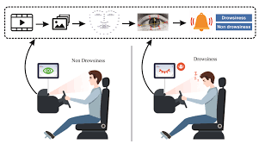
IMPLEMENTATION
Sleep Detection using the model.

Slide 7
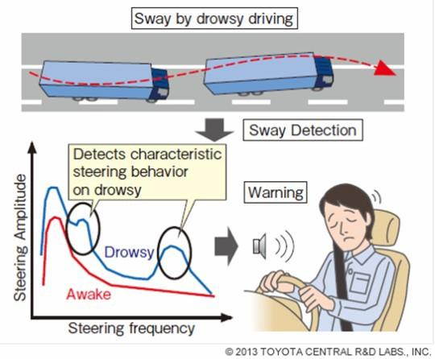
IMPLEMENTATION
Monitoring driving patterns using sensors.
Integration of Sleep Detection and Driving Patterns.
Alert the driver.

Slide 8
RESULTS AND DISCUSSION
Drawbacks in the existing sleep detection
Systems:
Bio-signal processing.
Facial feature alone.
Currently reliable system using following features:
Facial feature extraction.
Sleep detection.
Accelerometer and gyroscope readings.
Kalman filter.

Slide 9
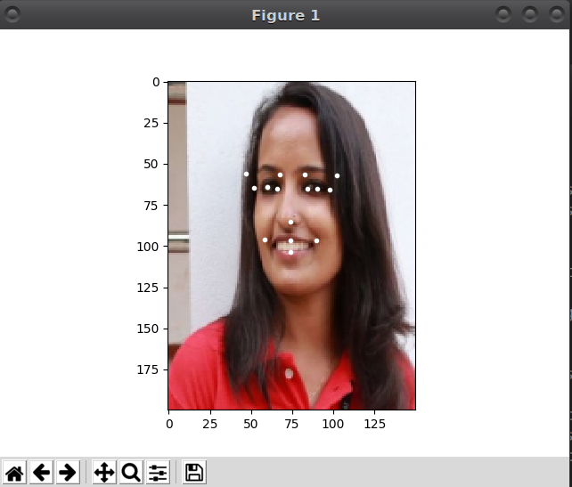
RESULTS AND DISCUSSION

Slide 10
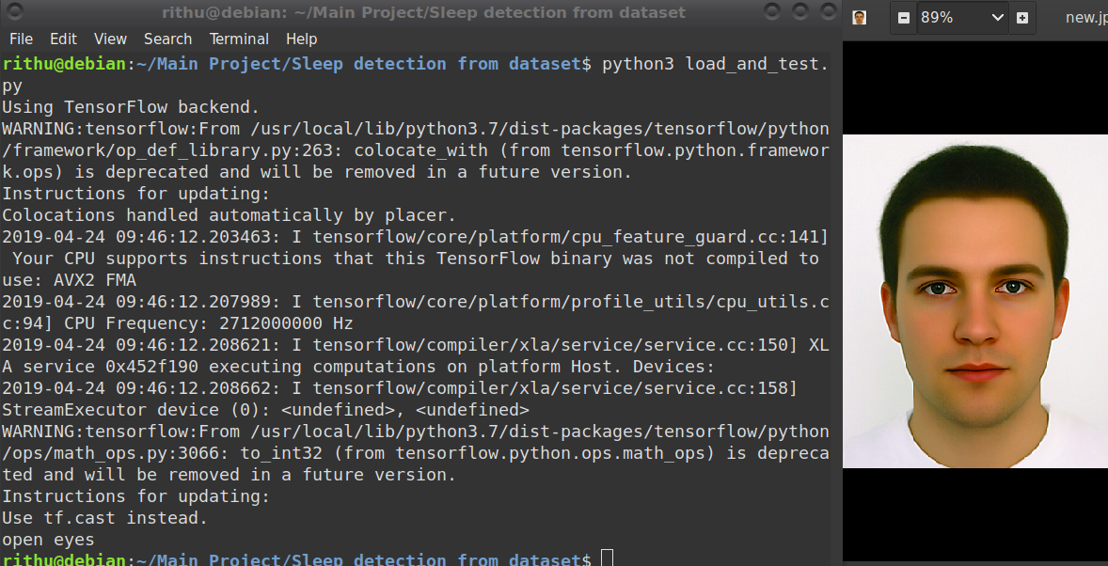
RESULTS AND DISCUSSION

Slide 11
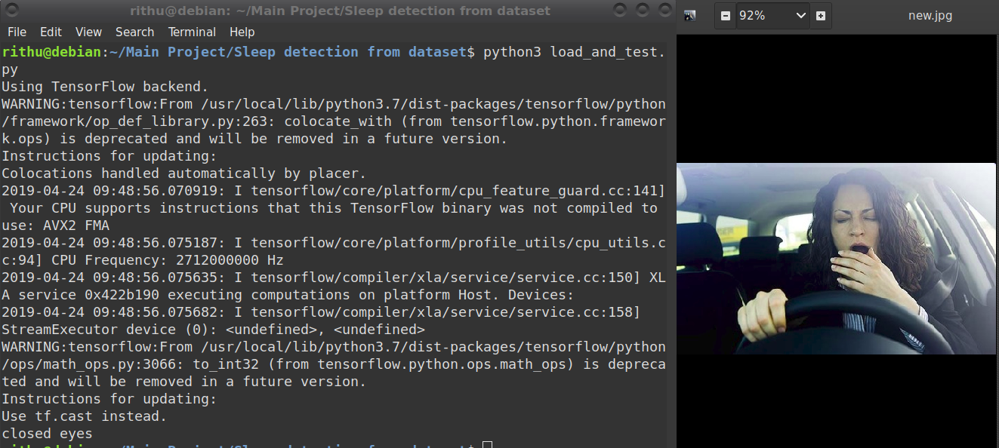
RESULTS AND DISCUSSION

Slide 12
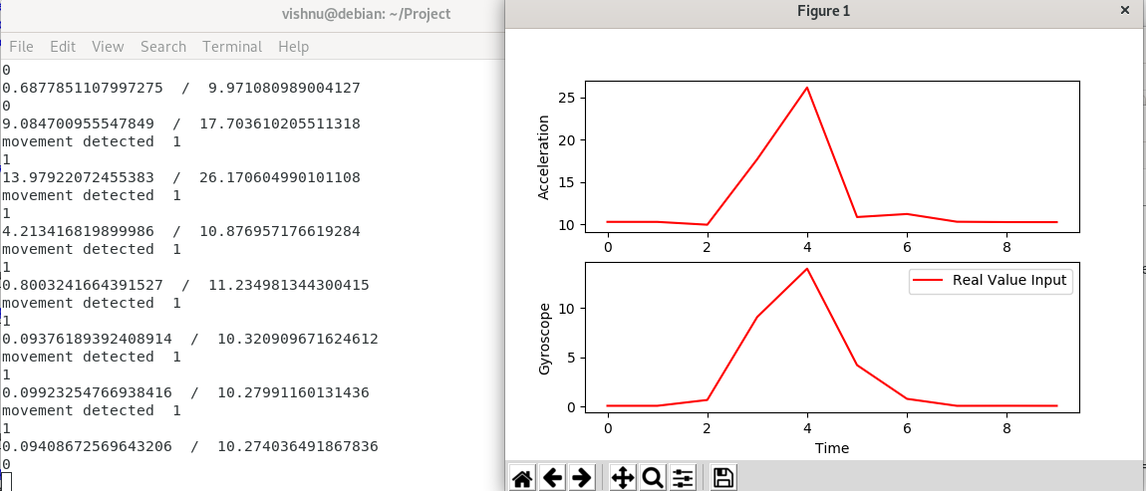
RESULTS AND DISCUSSION

Slide 13
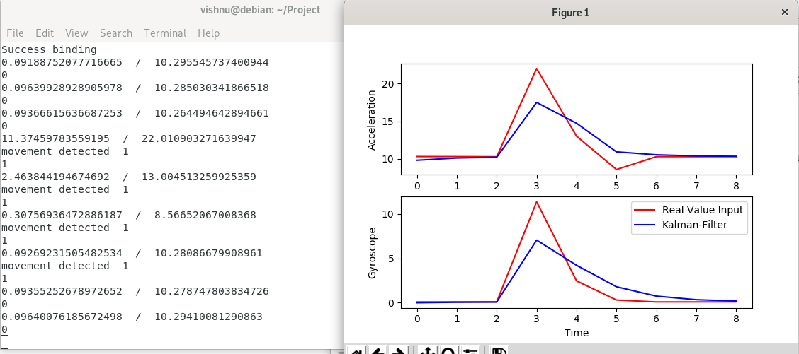
RESULTS AND DISCUSSION

Slide 14
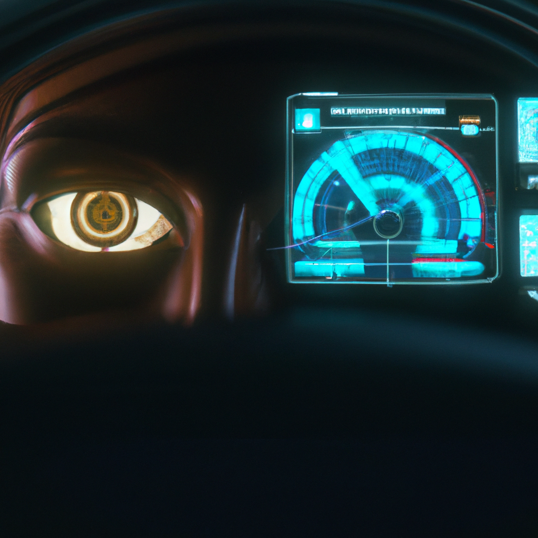
CONCLUSION
Reduce the occurrence of accidents.
Sleep detection and driver pattern anomaly.
Issue warning signal.

Slide 15
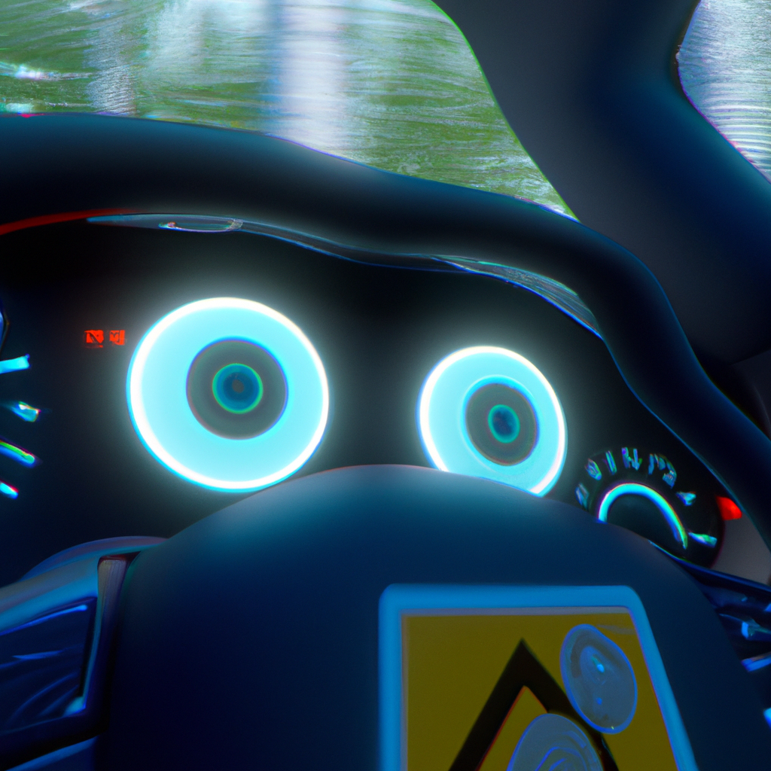
FUTURE SCOPE
Mobile applications based on this.
More accurate model.
Integration into the vehicle system itself.

Slide 16
THANK YOU

